Slide 1
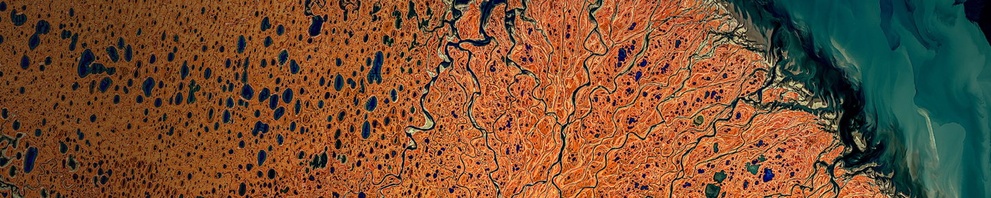
GeoParquet and GeoArrow in deck.gl
Kyle Barron
Cloud Engineer @ Development Seed

Slide 2
Motivation
How to Use
Technical Details
Demos

Slide 3
Simpler, faster rendering of large analytical vector datasets

Slide 4
Data rendering on the web
Three parts of web maps
Load data to the browser
Manage data in memory
Render to screen

Slide 5
Data rendering on the web
Three parts of web maps (slow)
Load data to the browser
Manage data in memory
Render to screen
GeoJSON
Massive file size
Very slow to read and write
No partial reads
GeoJSON-like JavaScript objects
Memory overhead
Can’t be shared with web worker or WebAssembly
High garbage collector overhead (many small JavaScript array objects)
deck.gl
Has to be converted back to binary buffers to be copied to the GPU

Slide 6
Binary data pipelines are fast
Three parts of web maps (fast)
Load data to the browser
Manage data in memory
Render to screen
GeoParquet
Fastest way to move data
Efficient compression
Remote partial reads (cloud-native)
Very fast to read and write
GeoArrow
Most efficient way to represent geospatial DataFrames
Binary buffers store entire column’s data
No serialization to share with web worker or WebAssembly
No garbage collector overhead
deck.gl
Fastest analytical map rendering on the web
Copy directly from GeoArrow memory to the GPU

Slide 7
GeoParquet
Most efficient file format for analytical vector data

Slide 8
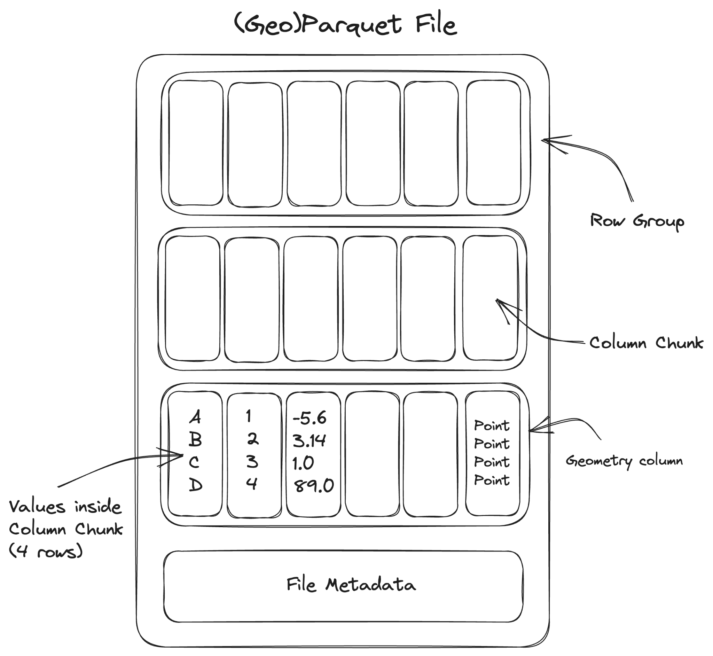
De-facto columnar file format for tabular data
Apache Parquet
Chunked, columnar data format
Extensive type system, including nested types
Extremely efficient compression
Implementations in JS (Wasm), Python, C, Java, Rust, etc.
Widely adopted
Snowflake, BigQuery, RedShift, Databricks
Hadoop, Spark, DuckDB
Pandas, Polars, Velox, DataFusion
Originated in 2013 with Hadoop

Slide 9
Geospatial support for Parquet
GeoParquet
Extends Parquet for geospatial data
Readable by non-geospatial tools
Cloud-native: read chunks of file efficiently via HTTP range requests
Use the same data files for backend analysis and frontend visualization
Increasing adoption:
GeoPandas, QGIS, Apache Sedona, GDAL/OGR
Future work: spatial partitioning
Specification recently hit 1.0

Slide 10
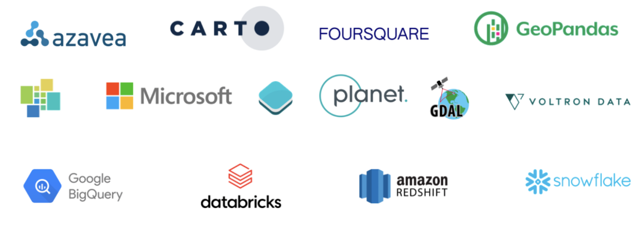
GeoParquet developed by broad community

Slide 11
GeoArrow
Enabling zero-copy data interoperability for geospatial

Slide 12
Enabling zero-copy data sharing for scientific Python libraries
Python Buffer Protocol (2006)
Problem: Expensive to copy & convert array data between Python libraries
Solution: Protocol for zero-copy sharing of multi-dimensional array data
Enabled widespread innovation on top of NumPy (v1.0 in 2006)
“This cannot be emphasized enough: it is fundamentally the Buffer Protocol and related NumPy functionality that make Python useful as a scientific computing platform.”
- Jake VanderPlas (An Introduction to the Python Buffer Protocol, 2014)

Slide 13
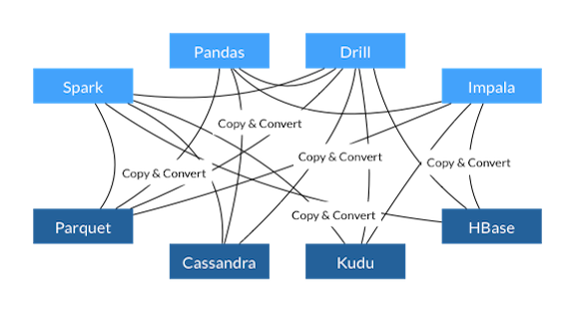
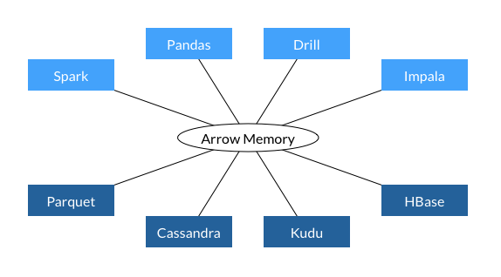
Before Arrow
Enabling zero-copy data sharing for tabular libraries
Apache Arrow (2015)
With Arrow
Problem:
Pandas library for tabular data implemented on top of NumPy
Expensive to copy & convert tabular data between languages
Solution:
Protocol for language-independent zero-copy sharing of columnar tabular data
Extensive type system, including nested types
Think of Arrow as equivalent data structure for pandas DataFrame
Has become the standard memory format for modern analytical tools:
Pandas, Polars, Velox, DuckDB, DataFusion, cuDF
Notes:
Motivating the talk in the reverse direction
DuckDB can operate on Python Arrow tables without copy

Slide 14
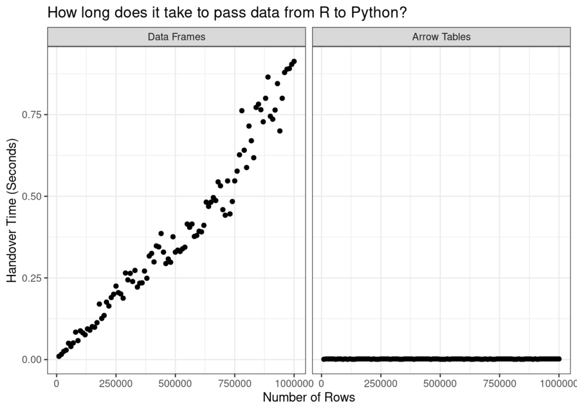
Enabling zero-copy data sharing for tabular libraries
Apache Arrow (2016)
Data sharing within a memory space is always O(1)
Here: R <--> Python 👉
But also: Web Workers, WebAssembly -> JS
Danielle Navarro (Passing Arrow data between R and Python with reticulate)
Notes:
Motivating the talk in the reverse direction
DuckDB can operate on Python Arrow tables without copy

Slide 15
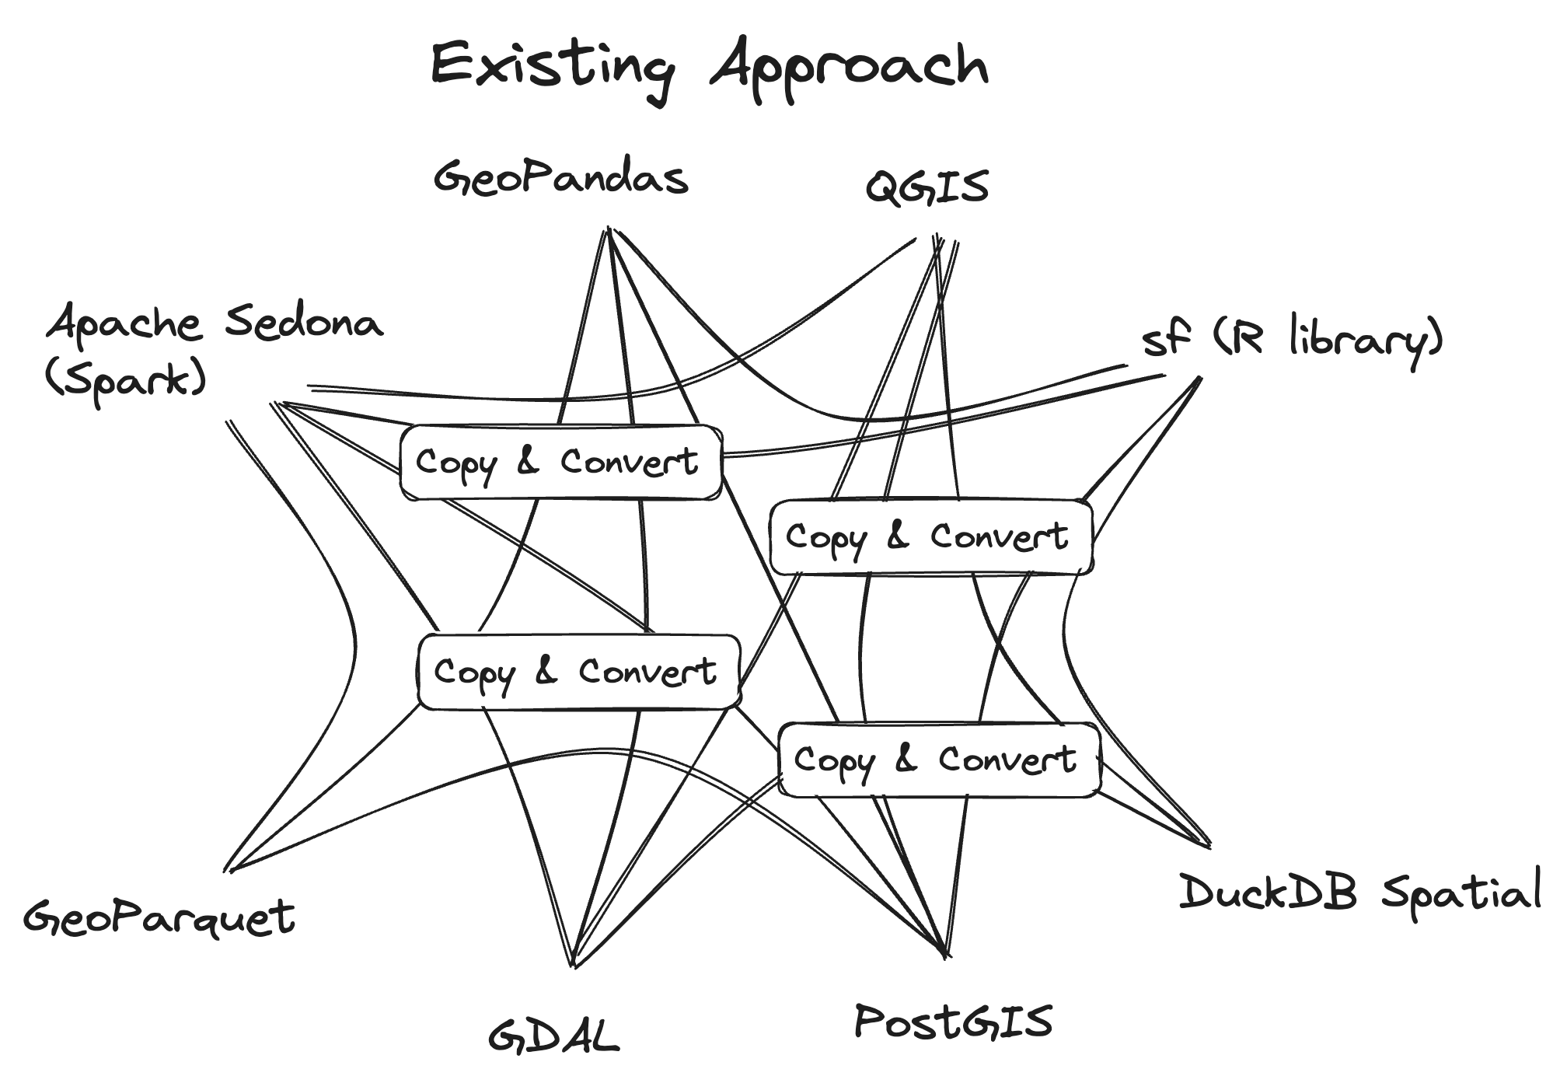
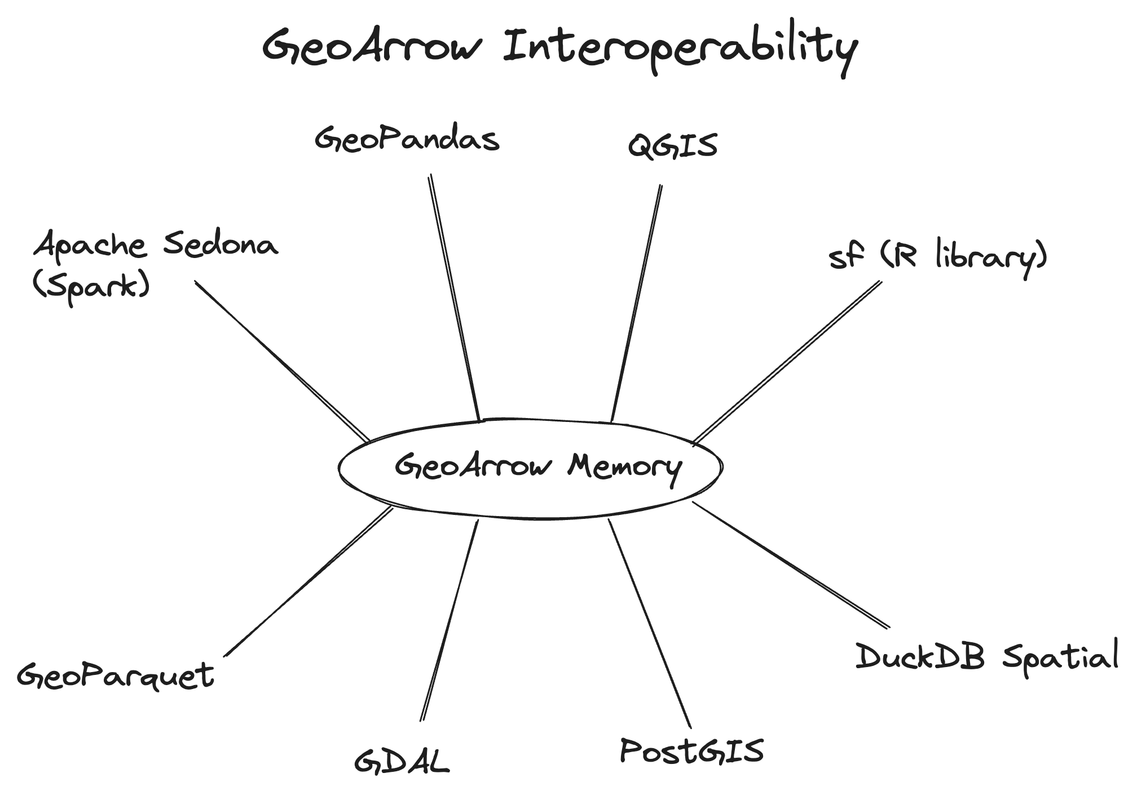
Enabling zero-copy data sharing for geospatial
GeoArrow (2020-)
Problem:
Expensive to copy & convert geospatial tabular data between systems
Python __geo_interface__ protocol exists but GeoJSON serialization is slow
Solution:
Protocol for language-independent zero-copy sharing of geospatial tabular data
Defines storage of vector geospatial data in Apache Arrow
Full Arrow type system available for attributes
Progress towards wide adoption:
GDAL RFC 86: Load any GDAL-supported vector format as a GeoArrow table.
Integrated into GeoPandas, DuckDB Spatial, cuSpatial
Notes:
Motivating the talk in the reverse direction

Slide 16
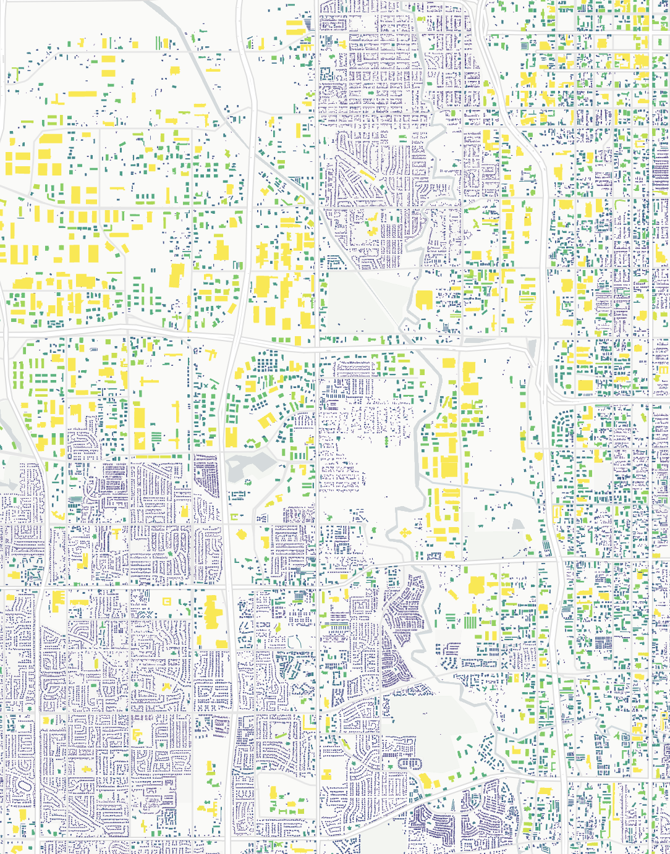
Interoperability is useful in JavaScript, too
GeoArrow in JavaScript
Instant data movement to/from Web Worker
Fast data movement to/from WebAssembly (zero-copy out)
Future integration with tools like duckdb-spatial in WebAssembly
👉 Building footprints colored by area; reprojection and area computed inside Wasm
Future high-performance applications will be Wasm-native, only making zero-copy views from JS for rendering.
Building a Rust-based GeoArrow-native geometry library that compiles to Wasm
https://observablehq.com/@kylebarron/prototyping-georust-geoarrow-in-webassembly
Notes:
Motivating the talk in the reverse direction

Slide 17
deck.gl
Fastest analytical map rendering on the web

Slide 18
Bandwidth is the browser's limiting factor for large data
Why deck.gl + GeoParquet?
Bandwidth is the browser's limiting factor for large data
Efficient compression: Parquet files are much smaller than comparable formats
Partitioning: Fetch only the requested columns/chunks of file
Spatial partitioning a future addition to GeoParquet spec
Cloud-native support: Fetch parts of the same files used for backend analytics
Notes:
Motivating the talk in the reverse direction

Slide 19
deck.gl’s binary API generally compatible with GeoArrow
Why deck.gl + GeoArrow?
ScatterplotLayer
Attributes
Buffer Layout
instancePositions
instanceRadius
instanceFillColors
instanceLineColors
instanceLineWidth
[x0, y0, z0, x1, y1, z1, …]
[r0, r1, …]
[R0, G0, B0, A0, R1, G1, B1, A1, …]
[R0, G0, B0, A0, R1, G1, B1, A1, …]
[w0, w1, …]
Slide from deck.gl Technical Deep Dive (Xiaoji Chen)

Slide 20
How to Use

Slide 21
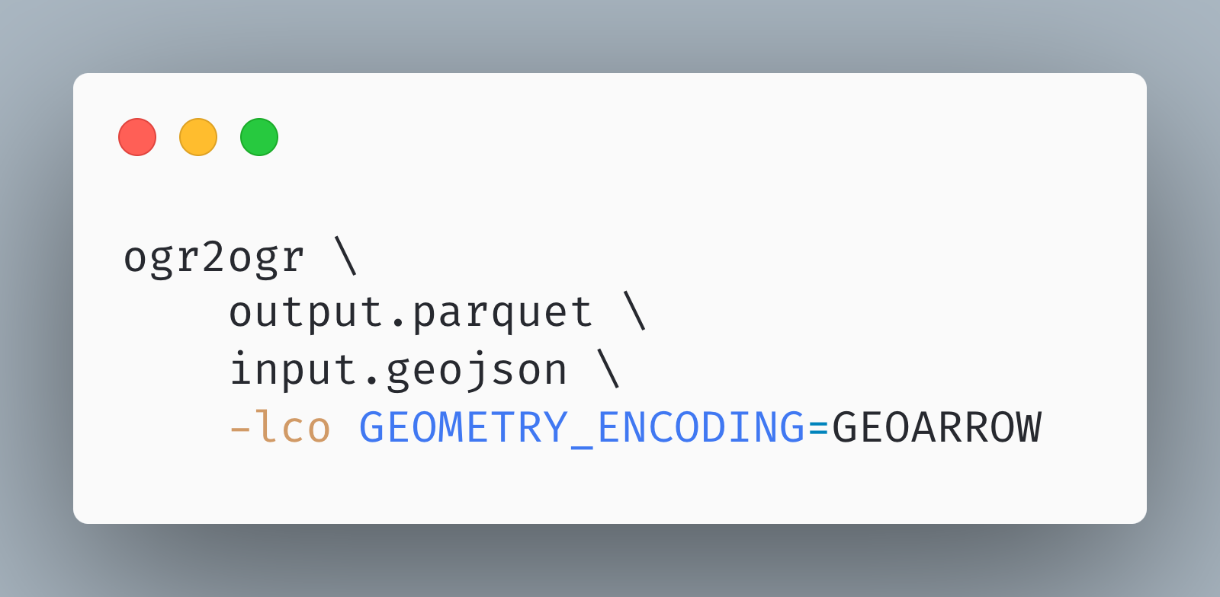
Construct the data
Creating GeoParquet with OGR
Easy to create with OGR since version 3.5
GeoArrow geometry encoding not valid GeoParquet 1.0
May be added to GeoParquet 1.1
GeoArrow-specific Python, Rust, C tooling in development
Notes:
Motivating the talk in the reverse direction

Slide 22
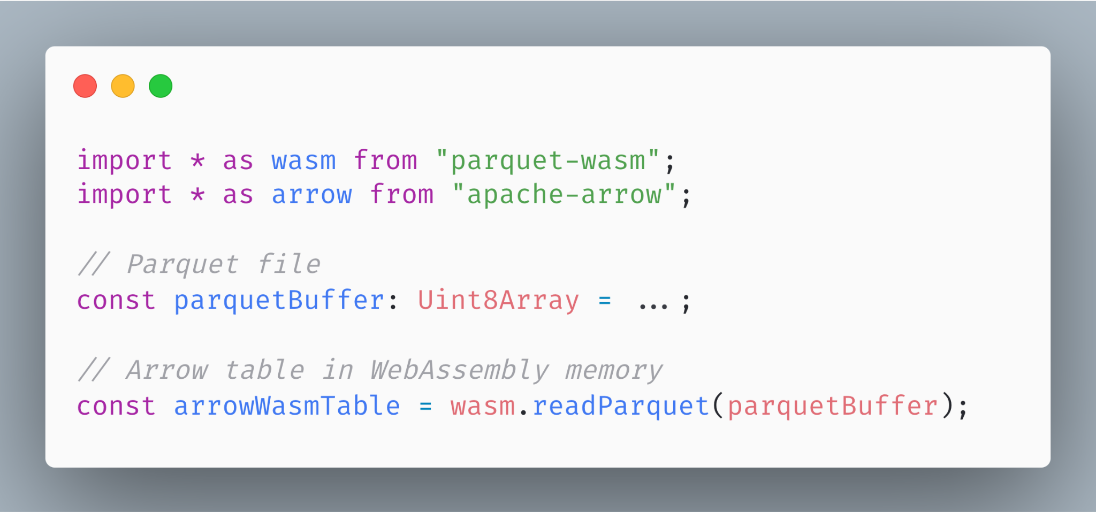
Fast, stable Parquet reading
parquet-wasm
WebAssembly (Rust) implementation of reading and writing Parquet
Parses Parquet into Arrow
GeoParquet file with 1M buildings (7M coords) parses in 1.3 seconds (mac pro 14” 2023)
Wasm bundle size:
309kb (no compressions)
741kb (all compressions)
961kb (all compressions + async support)
Notes:
Motivating the talk in the reverse direction

Slide 23
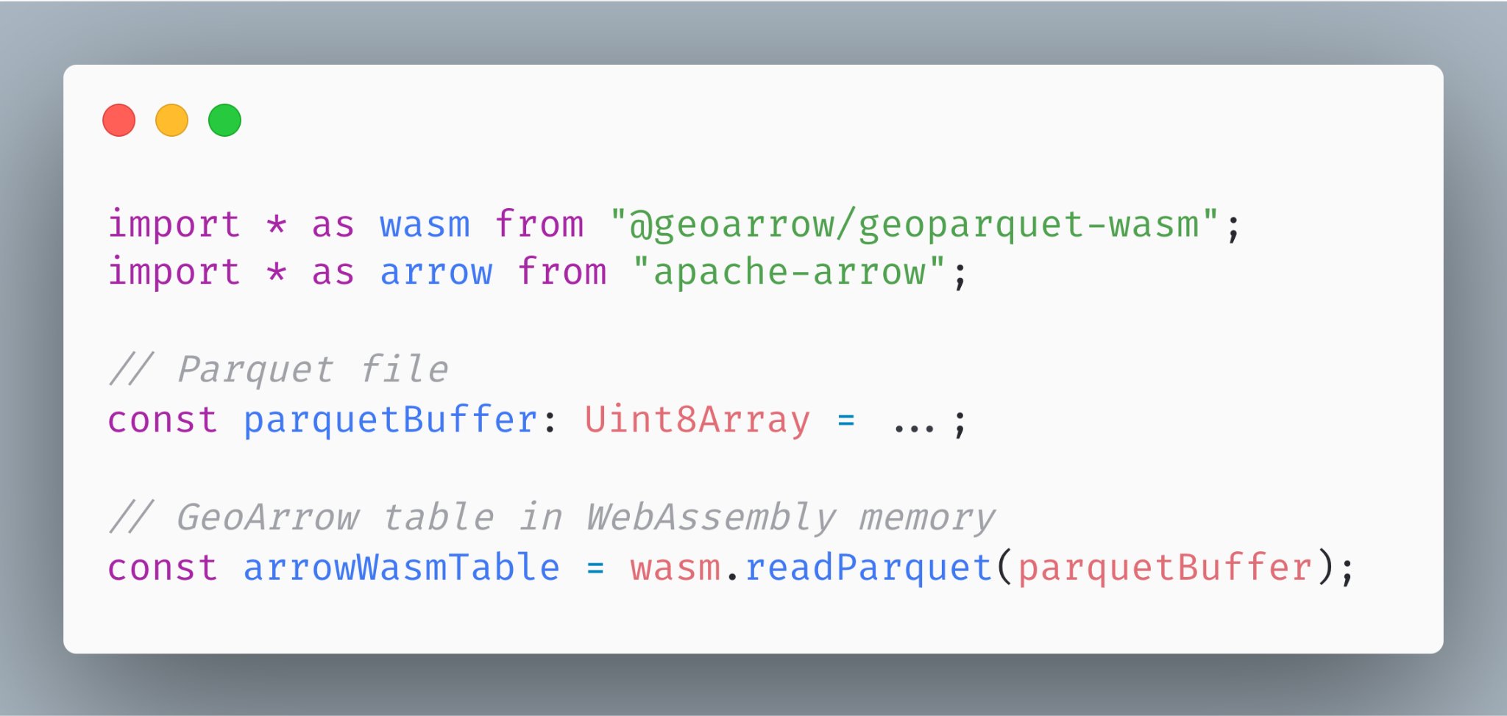
Fast, stable Parquet reading (with WKB parsing)
geoparquet-wasm
Adds Rust implementation of WKB parsing to parquet-wasm
Parses GeoParquet into GeoArrow
Will be published “soon” to NPM
Hopefully by end of 2023
Notes:
Motivating the talk in the reverse direction

Slide 24
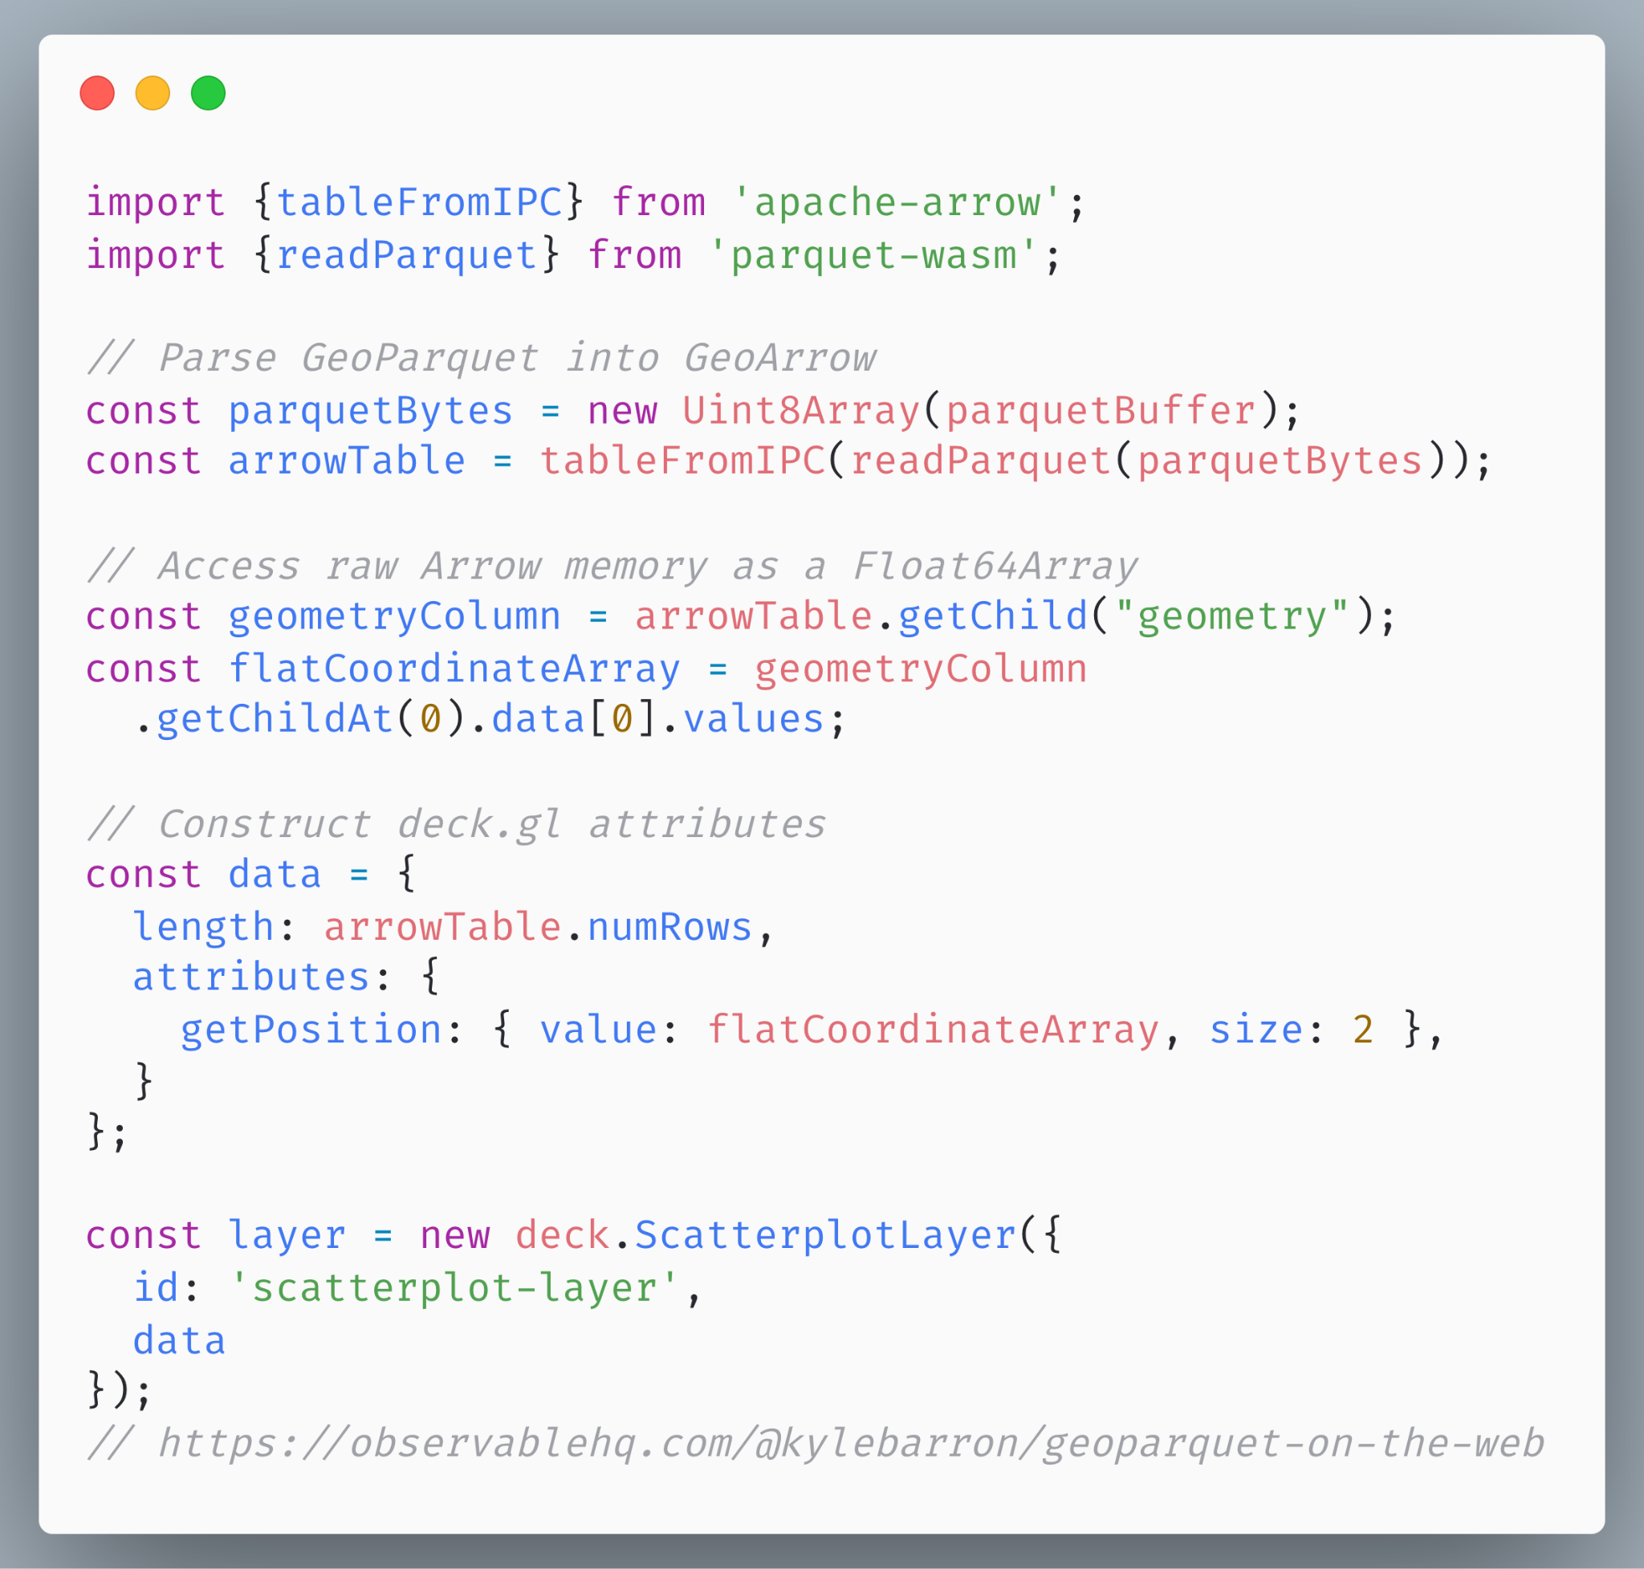
Using the binary API
deck.gl rendering (old)
Pass GeoArrow coordinate buffers into the deck.gl binary API
Downsides:
Very low level
Easy to mess up
Confusing footguns (i.e. accessor lengths must match vertex lengths)
Notes:
Motivating the talk in the reverse direction

Slide 25
Using the binary API
@geoarrow/deck.gl-layers
Brand-spanking new library
Simplifies using the deck.gl binary API
Mimics existing deck.gl layers:
ScatterplotLayer -> GeoArrowScatterplotLayer
PathLayer -> GeoArrowPathLayer
SolidPolygonLayer -> GeoArrowSolidPolygonLayer
Notes:
Motivating the talk in the reverse direction

Slide 26
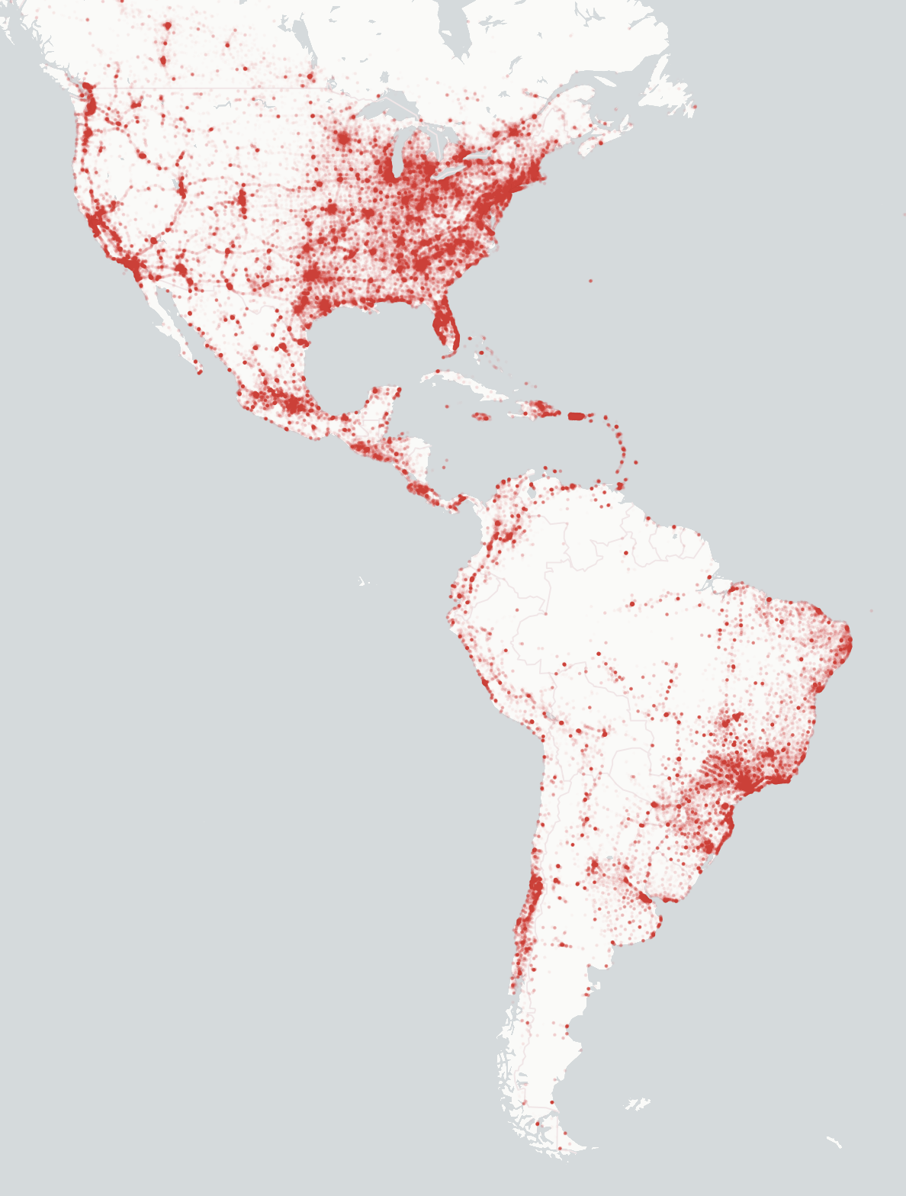
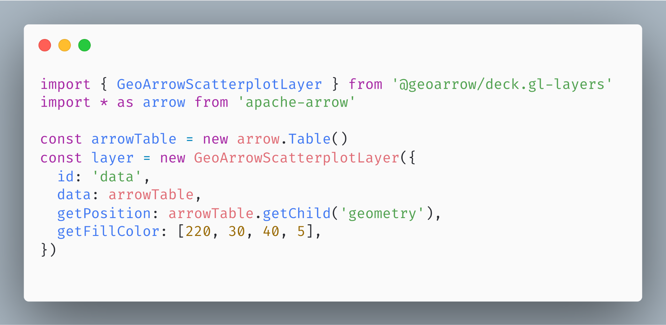
Using @geoarrow/deck.gl-layers
deck.gl rendering (new)
Notes:
Motivating the talk in the reverse direction

Slide 27
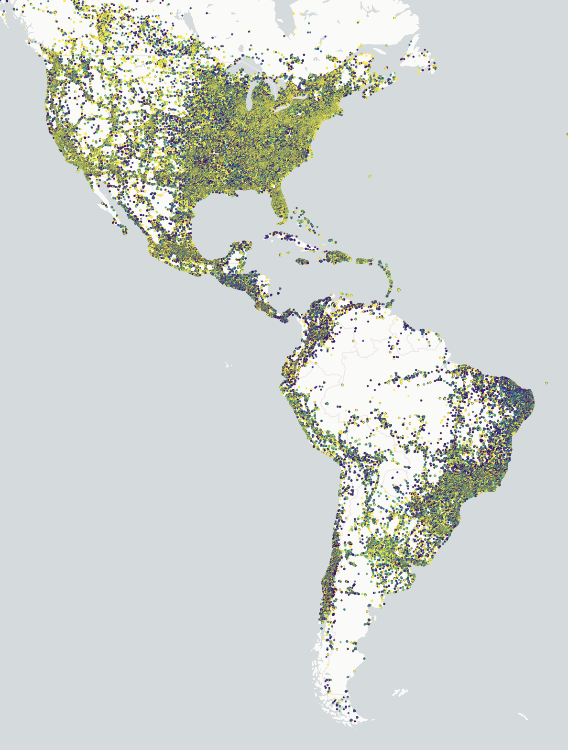
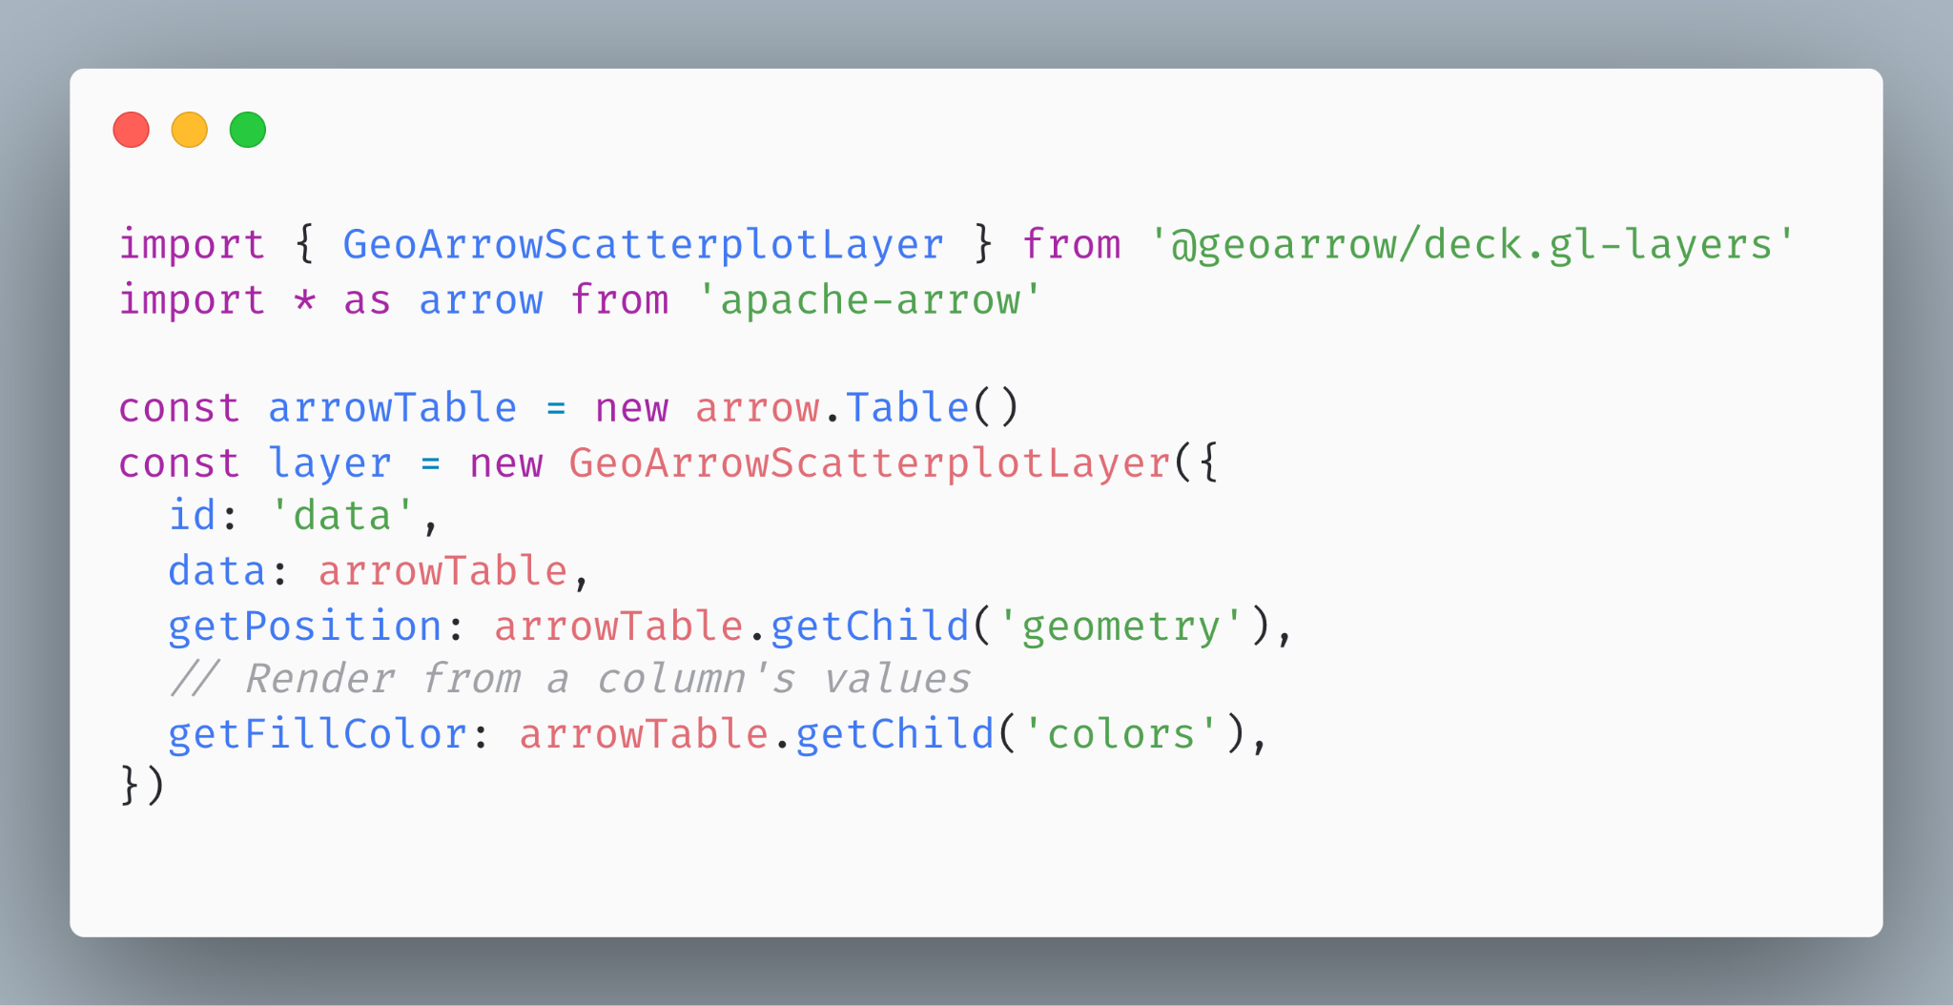
Using @geoarrow/deck.gl-layers
deck.gl rendering (new)
Notes:
Motivating the talk in the reverse direction

Slide 28
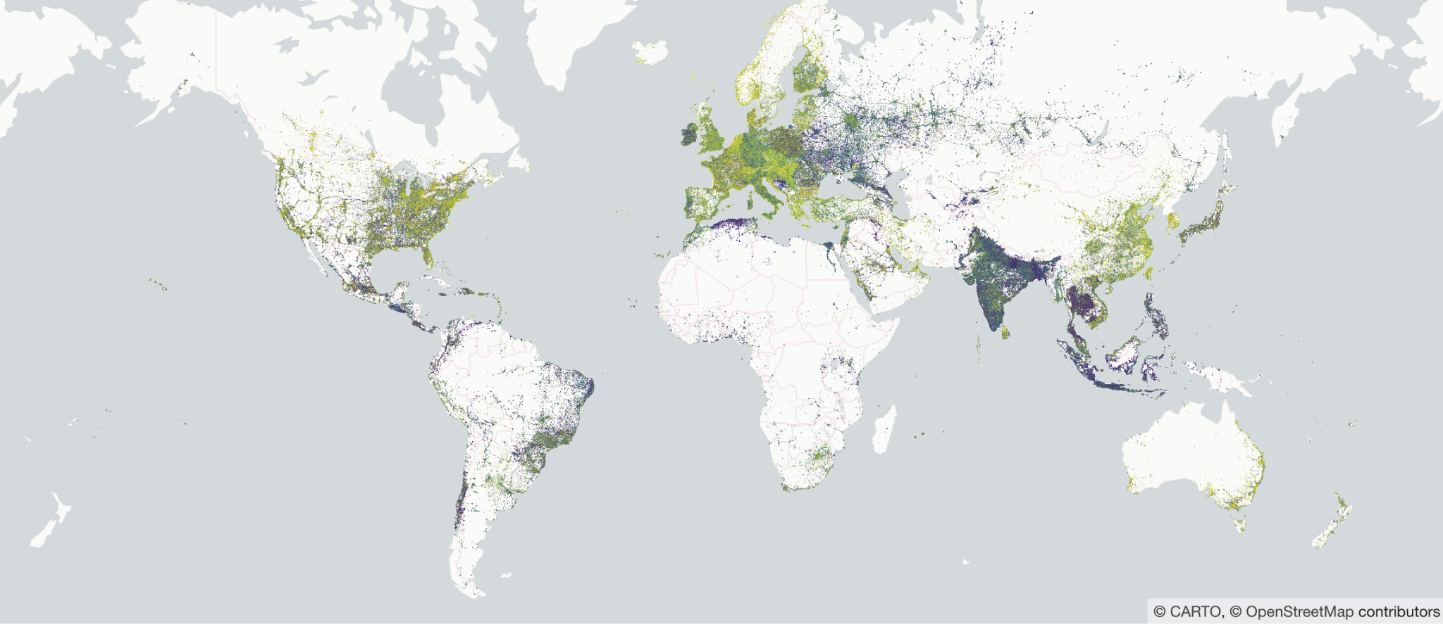
GeoParquet + GeoArrow + deck.gl
It’s really fast!
3.2 million points rendered in deck.gl
https://observablehq.com/@kylebarron/geoparquet-on-the-web
Notes:
Motivating the talk in the reverse direction

Slide 29

But… 99% of spatial data science happens in Python…
Can we link the two?

Slide 30
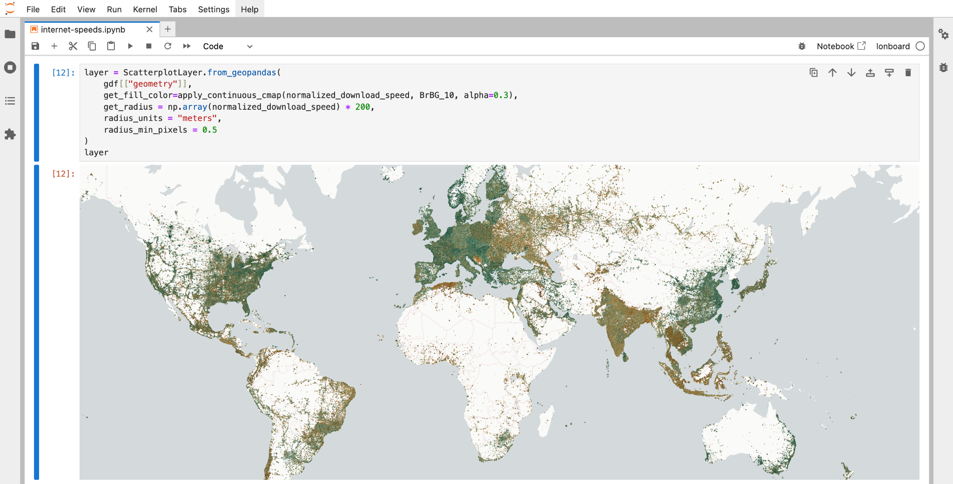
ds.io/lonboard
Enter lonboard

Slide 31
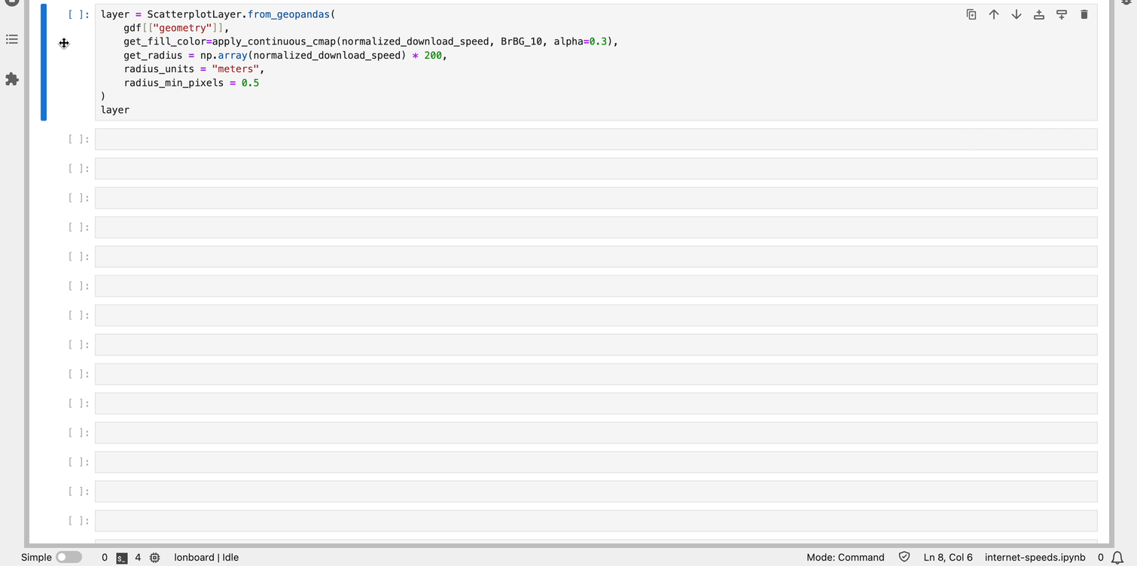
ds.io/lonboard
3M points in 2.5 seconds from Python

Slide 32
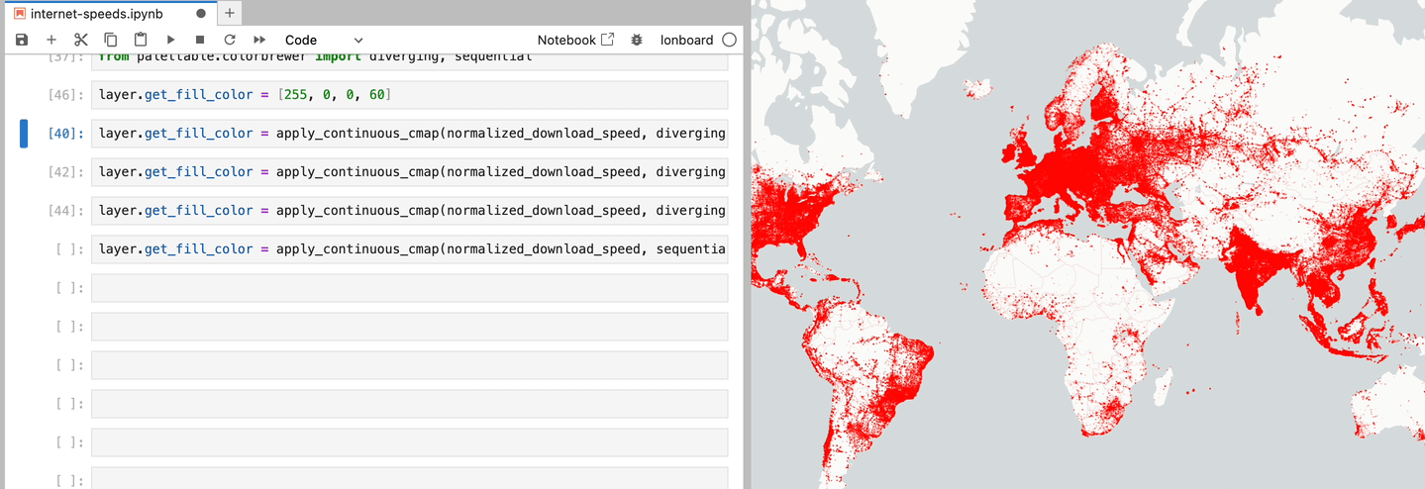
ds.io/lonboard
Swap colormaps in a fraction of a second

Slide 33
ds.io/lonboard
Performance Comparison
3 million points from a geopandas GeoDataFrame
ipyleaflet: 3min 30s (then crashed the notebook)
pydeck: 2min 23s (then crashed the notebook)
lonboard: 2.6s

Slide 34
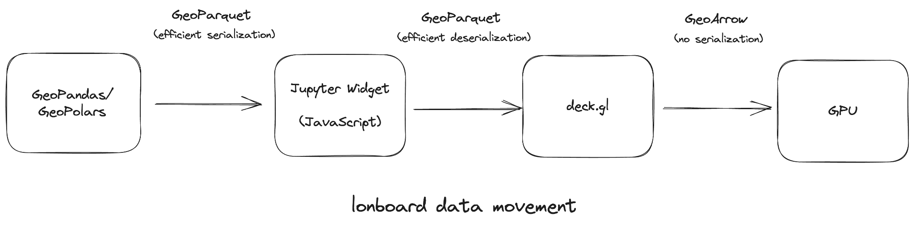
ds.io/lonboard
How is it so fast?
GeoArrow & GeoParquet throughout the data pipeline.
Python: GeoPandas to GeoArrow to Parquet.
Transfer compressed binary buffers to the Browser.
JavaScript: Decode Parquet to GeoArrow.
deck.gl: Pass GeoArrow buffers to the GPU.
Updating colors doesn’t modify main table.

Slide 35

ds.io/lonboard
What’s in a name?
A "deck" is the part of a skateboard you ride on. What's a fast, geospatial skateboard?
A lonboard.
Credit Kiri Carini & Dall-E & internet skateboarders’ training data

Slide 36
ds.io/lonboard
Caveats & Future Work
Very bleeding edge & new
Data transfer from remote Jupyter environments can crash kernel
Can’t yet render mixed-type geometries in a single column
Can’t yet render multiple data layers on a single map
Can’t yet show tooltip on hover

Slide 37
References
Lonboard: https://ds.io/lonboard
@geoarrow/deck.gl-layers: github.com/geoarrow/deck.gl-layers
geoparquet.org
geoarrow.org
Observable notebooks
https://observablehq.com/@kylebarron
https://observablehq.com/@developmentseed
Notes:
Motivating the talk in the reverse direction

Slide 38
kylebarron
kylebarron2
kylebarrongeo

